Slide 1
RECURSION
Introduction to programming
Shubham Dhungana

Slide 2
Recursion
In some problems, it may be natural to define the problem in terms of the problem itself.
Recursion is useful for problems that can be represented by a simpler version of the same problem.
Example: the factorial function
6! = 6 * 5 * 4 * 3 * 2 * 1
We could write:
6! = 6 * 5!

Slide 3
Example 2: factorial function
In general, we can express the factorial function as follows:
n! = n * (n-1)!
Is this correct? Well… almost.
The factorial function is only defined for positive integers. So we should be a bit more precise:
n! = 1 (if n is equal to 1)
n! = n * (n-1)! (if n is larger than 1)

Slide 4


factorial function
The C++ equivalent of this definition:
int fac(int numb){
if(numb<=1)
return 1;
else
return numb * fac(numb-1);
}
recursion means that a function calls itself

Slide 5
factorial function
Assume the number typed is 3, that is, numb=3.
fac(3) :
  3 <= 1 ? No.
  fac(3) = 3 * fac(2)
  fac(2) :
    2 <= 1 ? No.
    fac(2) = 2 * fac(1)
    fac(1) :
      1 <= 1 ? Yes.
      return 1
int fac(int numb){
if(numb<=1)
return 1;
else
return numb * fac(numb-1);
}
    fac(2) = 2 * 1 = 2
    return fac(2)
  fac(3) = 3 * 2 = 6
  return fac(3)
fac(3) has the value 6

Slide 6
factorial function
For certain problems (such as the factorial function), a recursive solution often leads to short and elegant code. Compare the recursive solution with the iterative solution:
Iterative solution
int fac(int numb){
int product=1;
while(numb>1){
product *= numb;
numb--;
}
return product;
}
Recursive solution
int fac(int numb){
if(numb<=1)
return 1;
else
return numb*fac(numb-1);
}

Slide 7
Recursion
We have to pay a price for recursion:
  calling a function consumes more time and memory than adjusting a loop counter.
  high performance applications (graphic action games, simulations of nuclear explosions) hardly ever use recursion.
In less demanding applications recursion is an attractive alternative for iteration (for the right problems!)

Slide 8
Recursion
If we use iteration, we must be careful not to create an infinite loop by accident:
for(int incr=1; incr!=10;incr+=2)
...
int result = 1;
while(result >0){
...
result++;
}
Oops!
Oops!

Slide 9
Recursion
Similarly, if we use recursion we must be careful not to create an infinite chain of function calls:
int fac(int numb){
return numb * fac(numb-1);
}
Or:
int fac(int numb){
if (numb<=1)
return 1;
else
return numb * fac(numb+1);
}
Oops!
No termination condition
Oops!

Slide 10
Recursion
We must always make sure that the recursion bottoms out:
A recursive function must contain at least one non-recursive branch.
The recursive calls must eventually lead to a non-recursive branch.

Slide 11
Recursion
Recursion is one way to decompose a task into smaller subtasks. At least one of the subtasks is a smaller example of the same task.
The smallest example of the same task has a non-recursive solution.
  Example: The factorial function
  n! = n * (n-1)! and 1! = 1

Slide 12
Example 3: Fibonacci numbers
//Calculate Fibonacci numbers using recursive function.
//A very inefficient way, but illustrates recursion well
int fib(int number)
{
if (number == 0) return 0;
if (number == 1) return 1;
return (fib(number-1) + fib(number-2));
}
int main(){ // driver function
int inp_number;
cout << "Please enter an integer: ";
cin >> inp_number;
cout << "The Fibonacci number for "<< inp_number
<< " is "<< fib(inp_number)<<endl;
return 0;
}

Slide 13
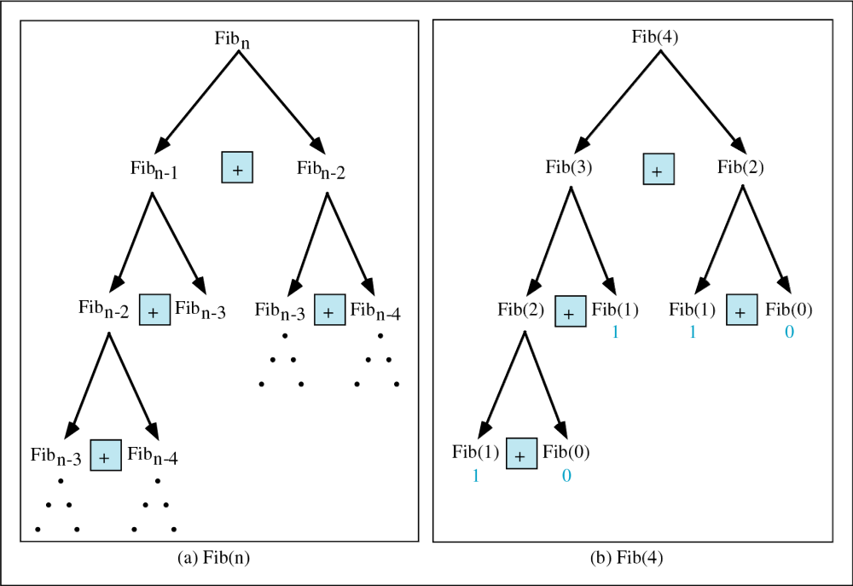
Copyright © 2000 by Brooks/Cole Publishing Company
A division of International Thomson Publishing Inc.

Slide 14
Trace a Fibonacci Number
int fib(int num)
{
if (num == 0) return 0;
if (num == 1) return 1;
return
(fib(num-1)+fib(num-2));
}
Assume the input number is 4, that is, num=4:
fib(4):
  4 == 0 ? No; 4 == 1? No.
  fib(4) = fib(3) + fib(2)
  fib(3):
    3 == 0 ? No; 3 == 1? No.
    fib(3) = fib(2) + fib(1)
    fib(2):
      2 == 0? No; 2==1? No.
      fib(2) = fib(1)+fib(0)
    fib(1):
    1== 0 ? No; 1 == 1? Yes.
    fib(1) = 1;
    return fib(1);

Slide 15
Trace a Fibonacci Number
fib(0):
    0 == 0 ? Yes.
    fib(0) = 0;
    return fib(0);
    fib(2) = 1 + 0 = 1;
    return fib(2);
  fib(3) = 1 + fib(1)
fib(1):
    1 == 0 ? No; 1 == 1? Yes
    fib(1) = 1;
    return fib(1);
  fib(3) = 1 + 1 = 2;
  return fib(3)

Slide 16
Trace a Fibonacci Number
fib(2):
      2 == 0 ? No; 2 == 1? No.
      fib(2) = fib(1) + fib(0)
      fib(1):
    1== 0 ? No; 1 == 1? Yes.
    fib(1) = 1;
    return fib(1);
    fib(0):
    0 == 0 ? Yes.
    fib(0) = 0;
    return fib(0);
    fib(2) = 1 + 0 = 1;
    return fib(2);
  fib(4) = fib(3) + fib(2)
  = 2 + 1 = 3;
  return fib(4);

Slide 17
Example 4: Fibonacci number w/o recursion
//Calculate Fibonacci numbers iteratively
//much more efficient than recursive solution
int fib(int n)
{
int f[100];
f[0] = 0; f[1] = 1;
for (int i=2; i<= n; i++)
f[i] = f[i-1] + f[i-2];
return f[n];
}

